Slide 1
BuildIt
By: James Baron

Slide 2


Background
IOS application
Construction task manager
Created to solve inefficiencies and miscommunication within the construction business
Business owners create and assign tasks for their employees

Slide 3
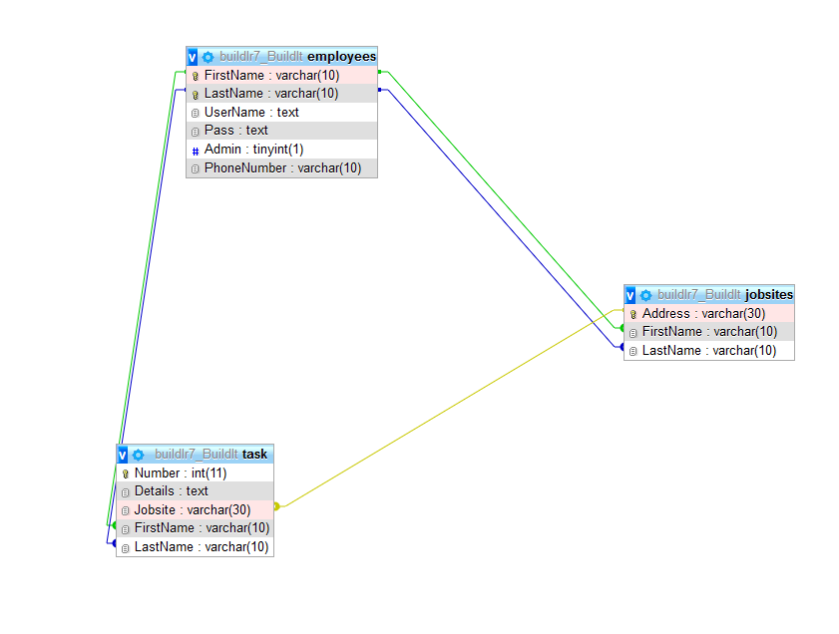
SQL Database (phpMyAdmin)

Slide 4
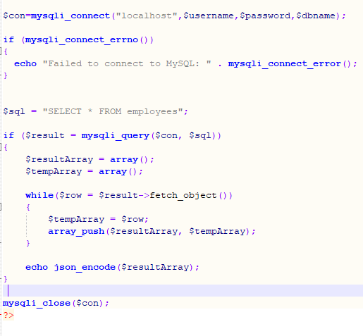
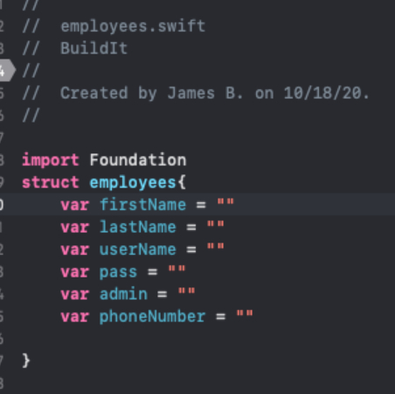
webservice

Slide 5
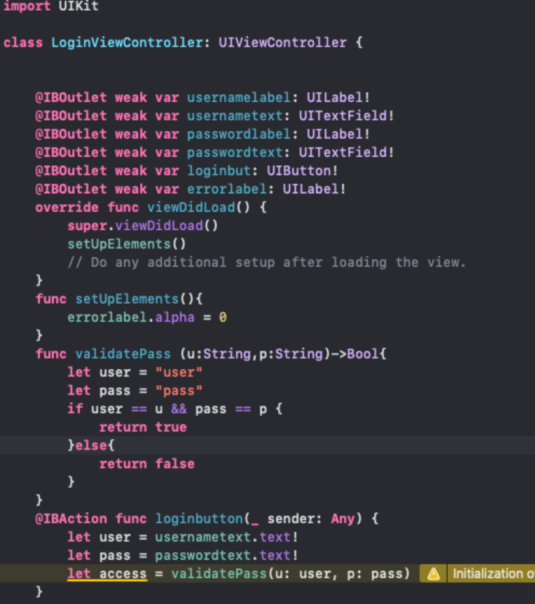
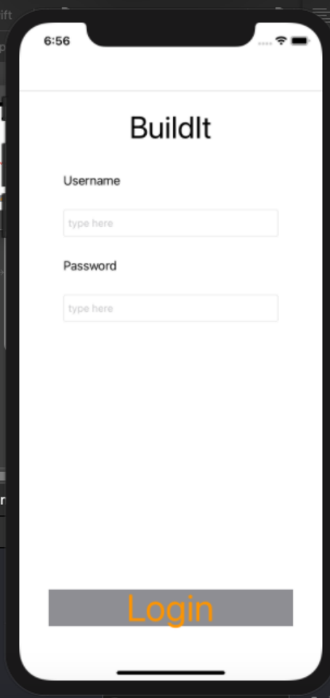
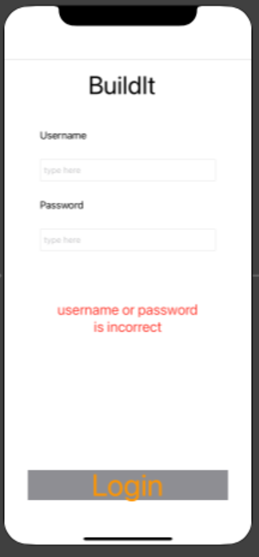
Login screen ui

Slide 6
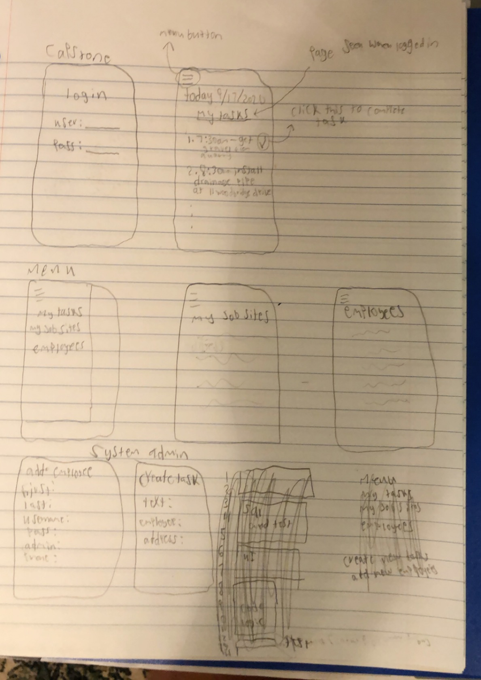
conclusion

